Slide 1

Welcome
Thursday, November 17, 2016
Zane State College, Cambridge
*As you wait for the meeting to begin, please complete the survey at your table.

Slide 2

Notes:
Wordle: There are the themes/defined needs identified by the AOP-20 meeting participants.

Slide 3
Supporting our mission
Education panel Children’s Defense Fund
Small town mayors’ panel National and state conference conference presentations
Jamie Meade-Battelle for Kids Library partnership
Innovation-Larry Triplett iBELIEVE Foundation
John Molinaro-APEG
Zane State President
Mid-East partnerships-Pioneer Pipe
Kindergarten students

Slide 4

Congratulations to AOP-20

Slide 5
Table Introductions-2 minutes per table
Name
Company or Organization you represent
“This is my first meeting.” or “This is what I remember most from previous meetings I’ve attended.”

Slide 6
HOPE and ASPIRATIONS from 3 perspectives
Our partners
Our students
Our Champion

Slide 7


Let’s hear from our Partner
Zane State College
Welcome Wendy Koil and students
Appalachian Teaching Project

Slide 8

Let’s hear from our Partner
Battelle for Kids
Tracey Najera
Appalachian New Economy Partnership

Slide 9

Let’s hear from students
Welcome Superintendent Matt Sheridan
Facilitator Heather Sands
Crooksville HS students

Slide 10


Slide 11


Cindy Miller, facilitator of Hope survey

Slide 12
Insert results of survey

Slide 13

Your reactions to survey results

Slide 14
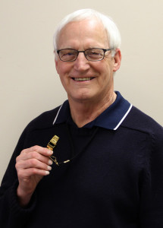
Let’s hear from Champion Dr. Jim Burson

Slide 15
Council Meetings for 2016-17
Thursday, February 9, 2017
Thursday, April 13, 2017

Slide 16

Notes:
Thanks to the many partners who
helped plan today’s events.
A special thank you to the Foundation for Appalachian Ohio for funding this event and to Zane State College for hosting.

