Slide 1

Welcome
First Council Meeting of 2016-17
Thursday, September 8, 2016
Zane State College, Cambridge

Slide 2
Welcome and Greetings
Dr. Larisa Harper, Assistant Provost, ZSC
David N. Branch, Muskingum Valley ESC Superintendent
Christopher Keylor, Ohio Valley ESC Superintendent

Slide 3
Meeting’s Purpose:
To share the work of AOP-20 in the region by convening different stakeholders.

Slide 4
Back-to-School Quiz
How many years has this council existed?
How many counties are represented by the council?

Slide 5
AOP-20 Nine County Region
Counties Served:
Coshocton
Guernsey
Hocking
Monroe
Morgan
Muskingum
Noble
Perry
Washington

Slide 6
Back-to-School Quiz
3. Why did we start AOP-20 Council?

Slide 7
What is our AOP-20 council?
Community, business and education leaders who have met for 2 years to:
examine regional student and work force needs
strategize ways with their existing resources to invest in opportunities for student success
strengthen the work force and the future of the community.
Notes:
We are strategizing ways
What we’ve done (we’ve been doing this) – examine…
Today’s meeting – strategize…
Outcomes that matter to all – strengthen…

Slide 8
Back-to-School Quiz
4. Can anyone name one of the BIG ROCKS that serve as one of our focus areas of this council?

Slide 9

Notes:
Wordle: There are the themes/defined needs identified by the AOP-20 meeting participants.

Slide 10
Collaboration of Education / Business
Planning and Vision
Career Development
Employer Needs
Aspiration
Five Big Rocks

Slide 11
What has happened since our last Council meeting in April?

Slide 12
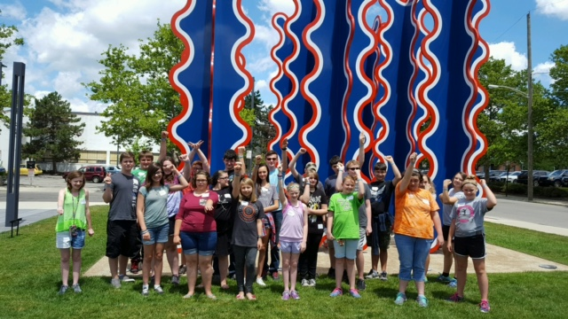
Muskingum County library students sporting their iCAN bracelets

Slide 13
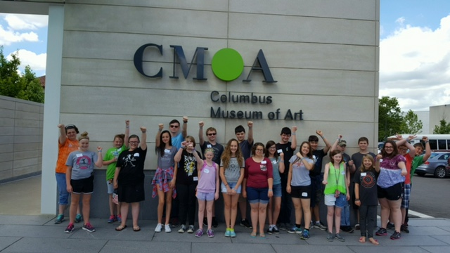
iCAN read…discover…learn

Slide 14

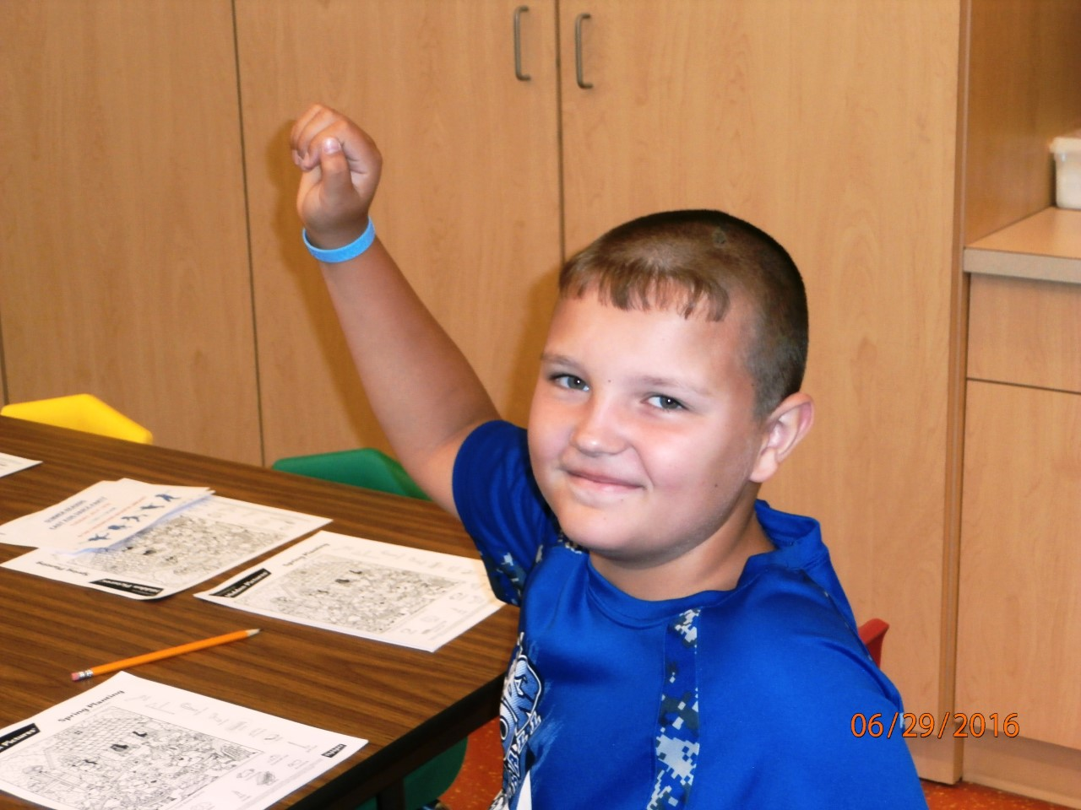
Crossroads library summer readers showing off their iCAN braclets

Slide 15
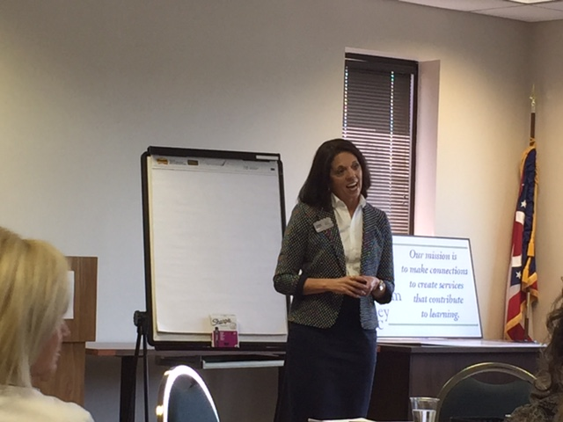
Jamie Meade speaks to area school districts on building Hope and Aspirations in our students.

Slide 16

Addressing barriers in our region
Sheriff Jeff Paden, Guernsey Co.
Deputy Jon Simmerman, Guernsey Co.
Karen Wiggins, Director, Alcohol and Drug Services of Guernsey County

Slide 17


Slide 18

Welcome Tonya Davis
Successful Students, Prosperous Communities

Slide 19

Welcome Patrick Klein

Slide 20


Slide 21
Council Meetings for 2016-17
Thursday, November 17, 2016
Thursday, February 9, 2017
Thursday, April 13, 2017

Slide 22

Notes:
Thanks to the many partners who
helped plan today’s events.
A special thank you to the Foundation for Appalachian Ohio for funding this event and to Zane State College for hosting.

